Slide 1

Powder Coating Oven
Verina Abdelmesih
Desiree Dee
Amber Malenowsky
Hussain Alismail

Slide 2
Project Description
Goal
Design a mobile powder coating oven that can be used by all programs
Work with the bumper capstone team
Powered by a propane fueled torpedo heater
Controlled using a PID control system
Stakeholder
The Renewable Energy Lab
Client
Carson Pete
The powder coating machine will be housed in the renewable energy lab
Verina 4/5/23

Slide 3
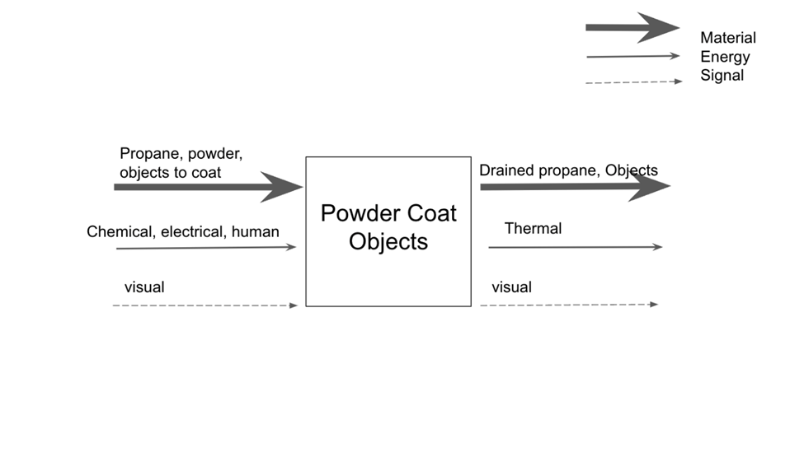
Function Decomposition
Input
Propane
Human
Output
Thermal energy
Powder coated objects
Amber 4/5/23

Slide 4
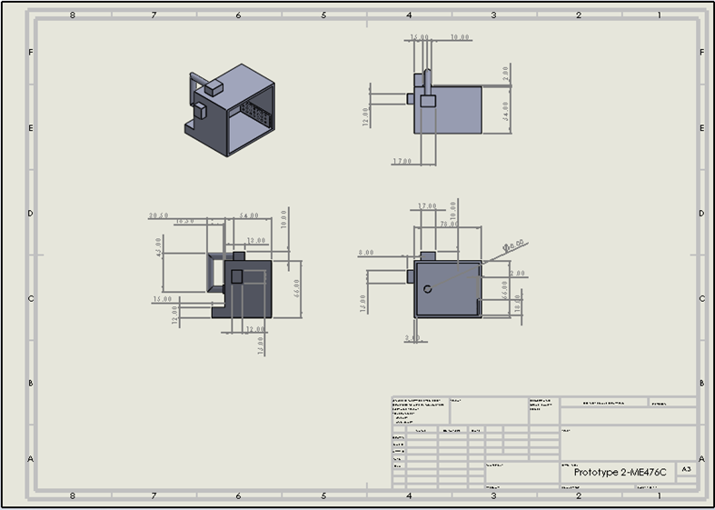
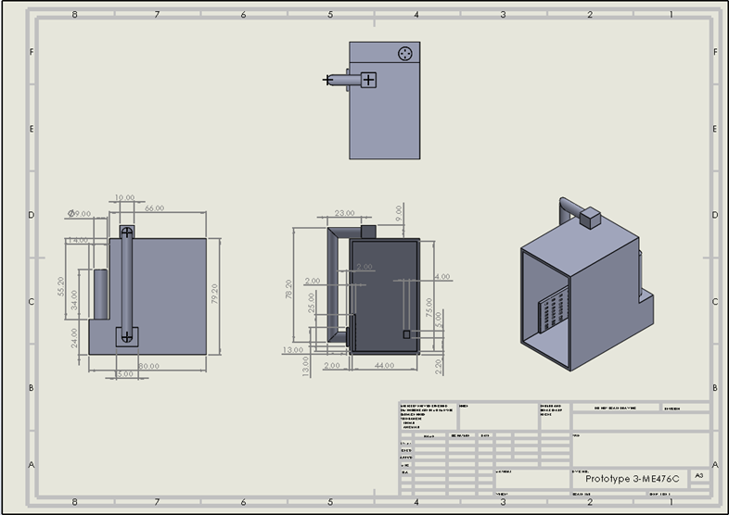
Concept Generation
Pros
Volume
Cost
Cons
Ventilation System
Reach 500 F
Design 2
Design 3
Desiree 4/5/23

Slide 5
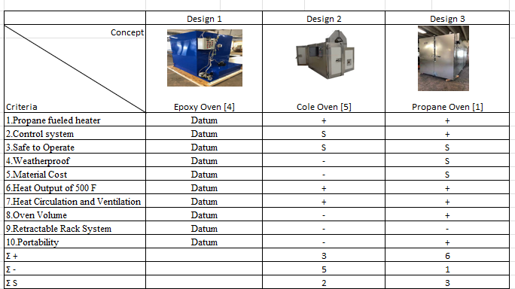
Concept Evaluation
Design one is the datum
Design two was the worst design
Design 3 was the best design
Desiree 4/5/23

Slide 6
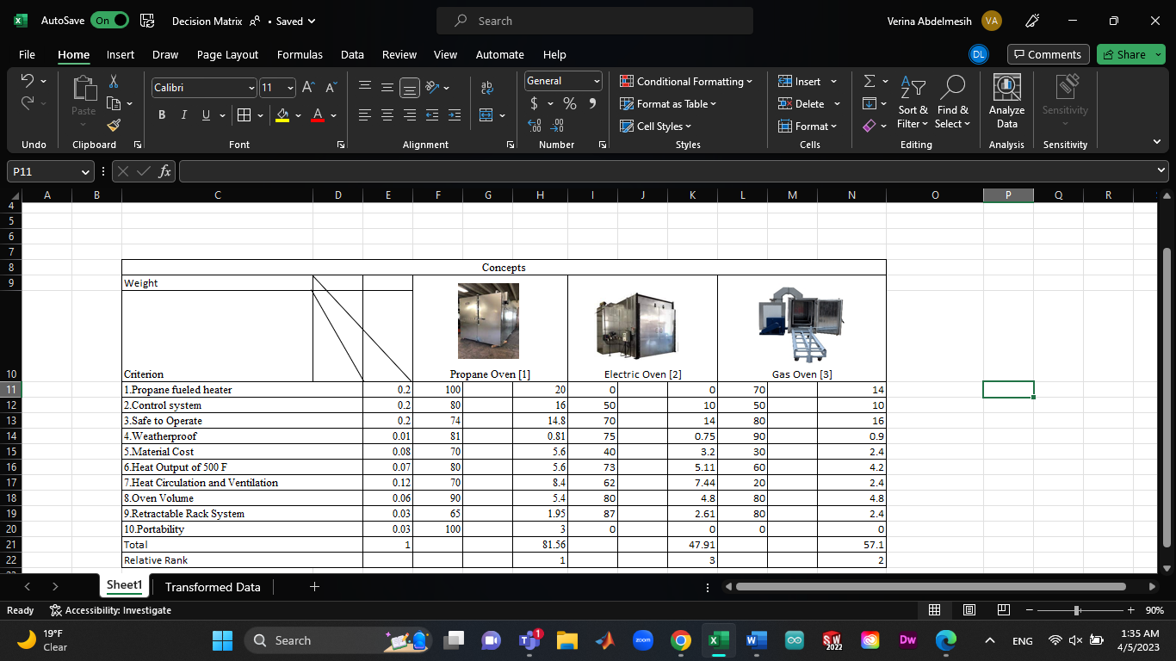
Concept Evaluation
Least Important
Portability
Retractable rack system
Most Important
Safety Requirement
Propane Fuel Heater
Control System
Hussain 4/5/23

Slide 7
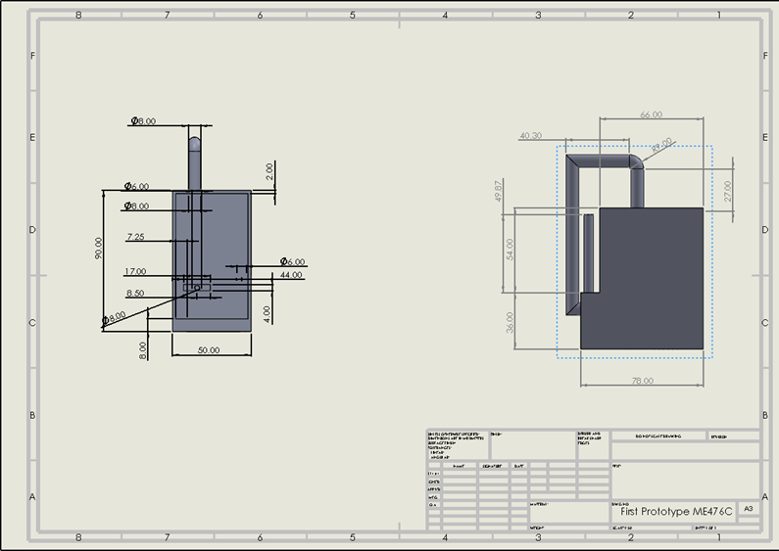
Concept Evaluation
Hussain 4/5/23

Slide 8
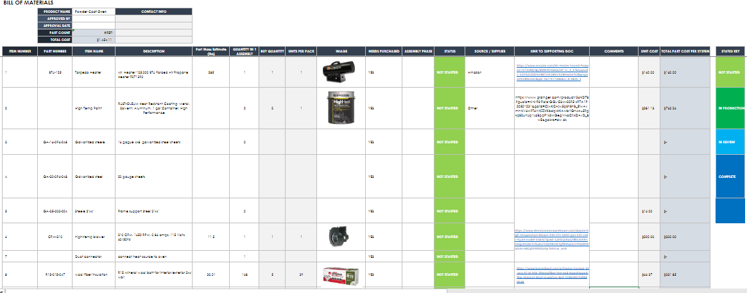
Budget planning
Target budget for oven build: $1000 to $1500​
Torpedo propane heater, high temp fan and mineral wool insulation ​
Expected Prototyping costs: $50 to $100
Amber 4/5/23

Slide 9
Reference
[1] “Natural gas/propane powder coating oven,” EPTEX Coatings, 16-Jul-2020. [Online]. Available: https://www.eptexcoatings.com/product/gas-powder-coating-oven/. [Accessed: 05-Apr-2023].
[2] Google image result for https://reliantfinishingsystems.com/wp-content/uploads/2021/09/industrial-oven-1024x1024.jpg. [Online]. Available: https://www.google.com/imgres?imgurl=https%3A%2F%2Freliantfinishingsystems.com%2Fwp-content%2Fuploads%2F2021%2F09%2FIndustrial-Oven-1024x1024.jpg&tbnid=5WWRef0sxptOqM&vet=12ahUKEwiRlqrTipL-AhV-OEQIHfI_Du4QMygDegUIARDBAg..i&imgrefurl=https%3A%2F%2Freliantfinishingsystems.com%2Felectric-powder-coating-ovens%2F&docid=3zbYiGoZRUgp7M&w=1024&h=1024&q=electric+fueled+powder+coating+oven&ved=2ahUKEwiRlqrTipL-AhV-OEQIHfI_Du4QMygDegUIARDBAg. [Accessed: 05-Apr-2023].
[3] “[hot item] electrostatic gas powered powder coat curing oven,” Made. [Online]. Available: https://coatingsystem.en.made-in-china.com/product/UNwxSgeMZnku/China-Electrostatic-Gas-Powered-Powder-Coat-Curing-Oven.html. [Accessed: 05-Apr-2023].
[4] Google image result for https://www.industrialoven.com/images/product/epoxy-curing-oven-3.jpg. [Online]. Available: https://www.google.com/imgres?imgurl=https%3A%2F%2Fwww.industrialoven.com%2Fimages%2Fproduct%2Fepoxy-curing-oven-3.jpg&tbnid=OH8udpBi6CFvSM&vet=12ahUKEwid6Z-Rx5P-AhUcMUQIHWVSCB4QMygZegUIARDcAw..i&imgrefurl=https%3A%2F%2Fwww.industrialoven.com%2Fepoxy-curing-oven.html&docid=rkVoP2ycLYWGYM&w=501&h=398&q=epoxy+oven&ved=2ahUKEwid6Z-Rx5P-AhUcMUQIHWVSCB4QMygZegUIARDcAw. [Accessed: 05-Apr-2023].

Slide 10
Reference
[5] Google image result for https://resourcewebsite.singoo.cc/14772778143583715/en/image/computer_5f100d9d2485c.jpg?x-oss-process=image/resize,w_2500/watermark,type_d3f5lxplbmhlaq,text_d3d3lmnvbg8tz3jvdxauy29t,t_50,color_cc8d7b,size_20,shadow_0,rotate_0,fill_0,g_center,x_10,y_10,voffset_0. [Online]. Available: https://www.google.com/imgres?imgurl=https%3A%2F%2Fresourcewebsite.singoo.cc%2F14772778143583715%2Fen%2Fimage%2Fcomputer_5f100d9d2485c.jpg%3Fx-oss-process%3Dimage%2Fresize%2Cw_2500%2Fwatermark%2Ctype_d3F5LXplbmhlaQ%2Ctext_d3d3LmNvbG8tZ3JvdXAuY29t%2Ct_50%2Ccolor_cc8d7b%2Csize_20%2Cshadow_0%2Crotate_0%2Cfill_0%2Cg_center%2Cx_10%2Cy_10%2Cvoffset_0&tbnid=y4nuddo6fKCCZM&vet=12ahUKEwjRu5C-x5P-AhVcN0QIHSUCA7EQMygjegUIARChAw..i&imgrefurl=https%3A%2F%2Fwww.colo-group.com%2Fpowder-coating-ovens.html&docid=GE0UAxKvPiwhzM&w=501&h=334&q=cole+powder+coating+oven&ved=2ahUKEwjRu5C-x5P-AhVcN0QIHSUCA7EQMygjegUIARChAw. [Accessed: 05-Apr-2023].

